Slide 1
FINAL PROJECT:
Machine Learning model for inventory optimization
Alberto Quiroz
Ricardo Donoso
Juan Pedro Martínez
Emilio Segura

Slide 2
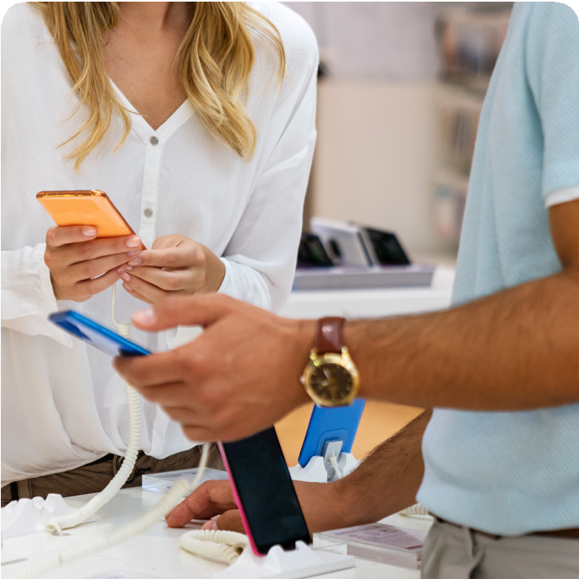





Mision
Satisfy the comunication needs of our clients giving them the best products and services.
Vision
Become a leading company in telecomunication and tech industry in El Bajio.
The company has 30 different stores in 3 different states in El Bajio (Queretaro, Guanajuato and Jalisco)
Company Background
Dimovil is a Mexican company that commercializes electronic devices within the central and western regions of the country. With 30 branches.
Reason
The reason for selecting this project is because Dimovil is currently trying to find a way to optimize their turnover inventory on their cell phone devices as well as reduce obsolete inventory on low turnover per location.

Slide 3
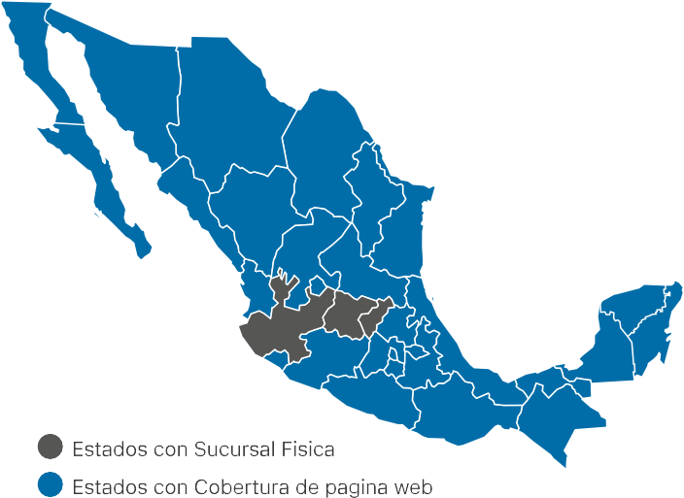


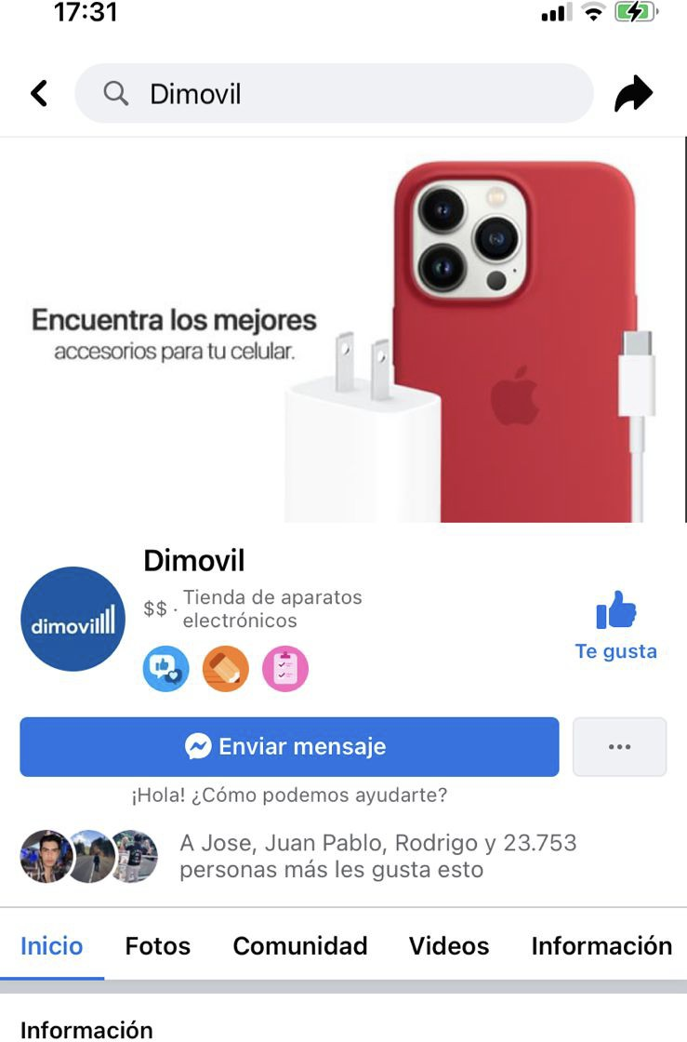



Slide 4
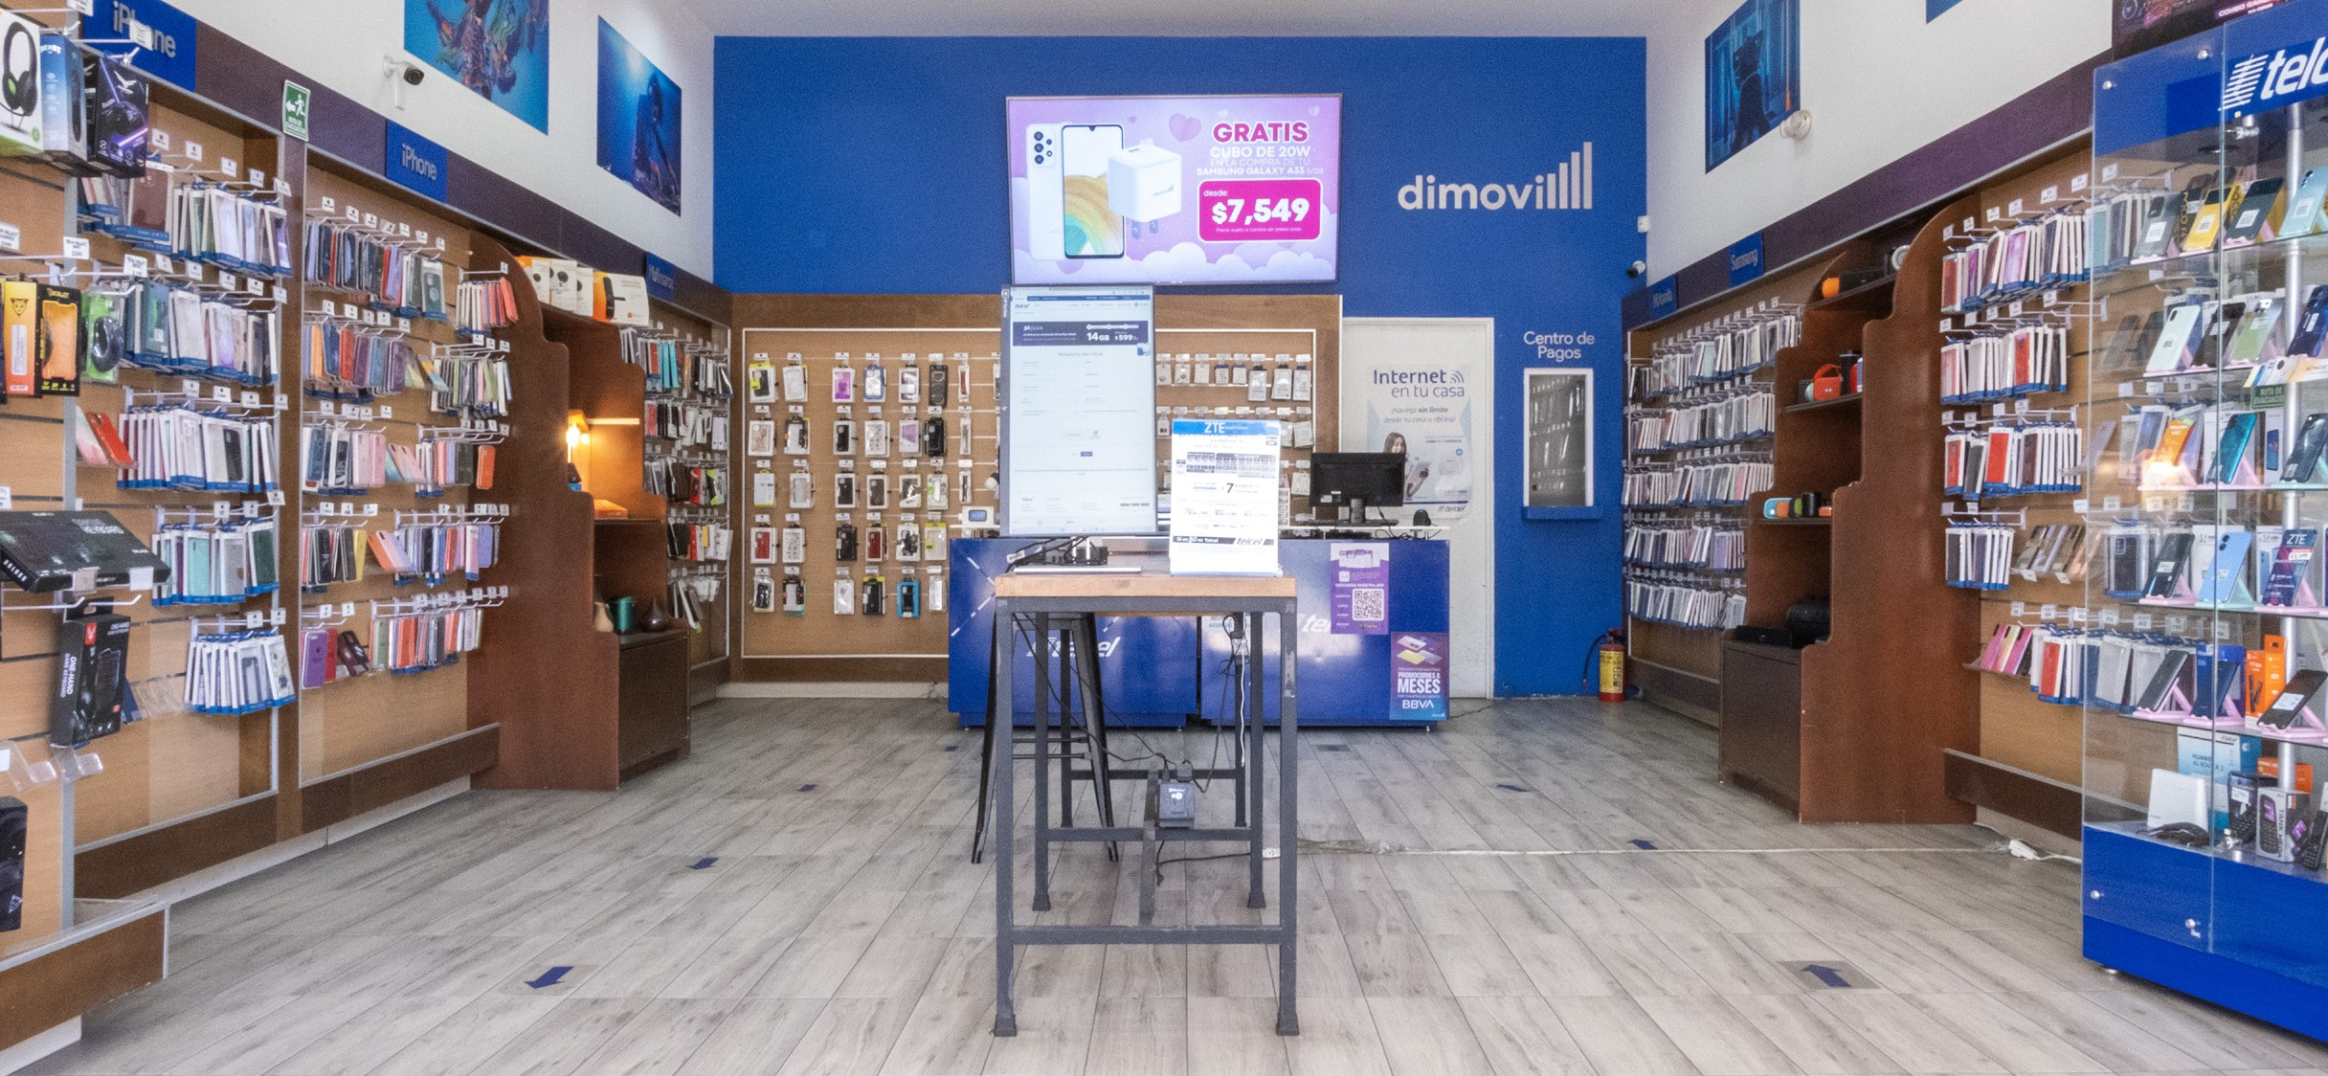
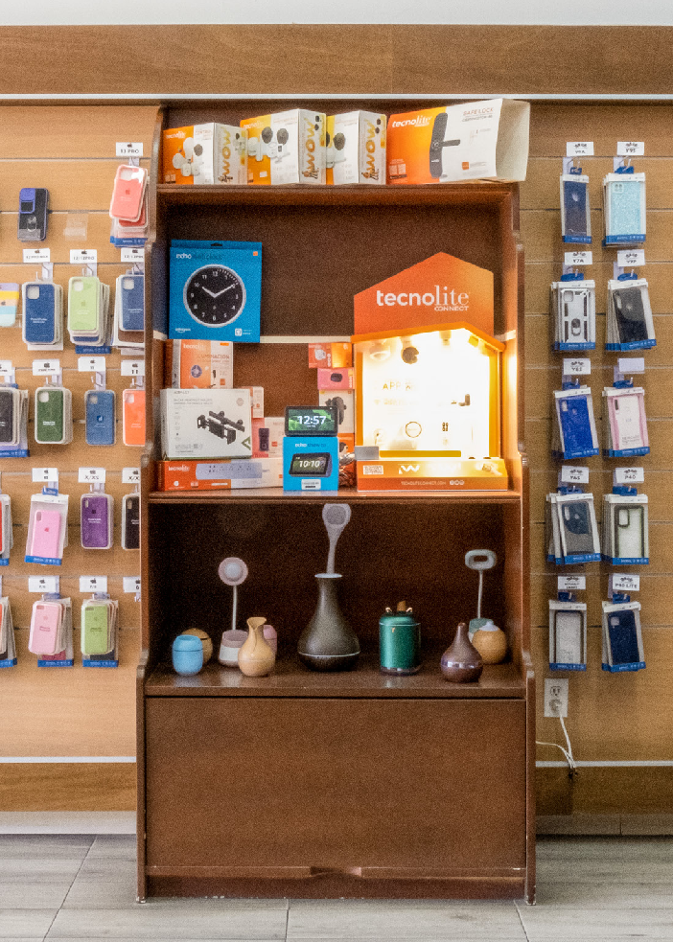
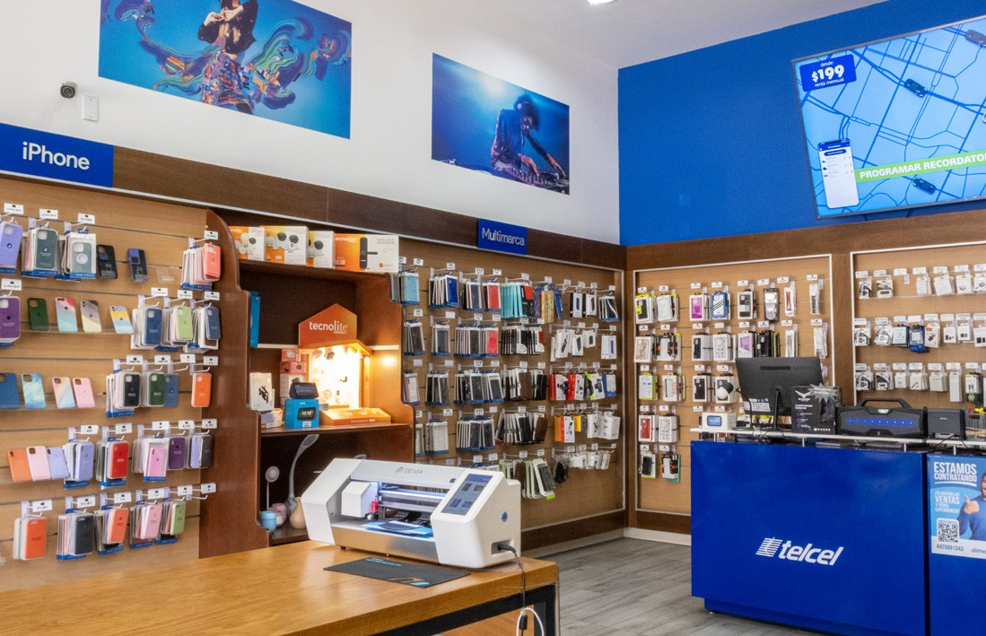
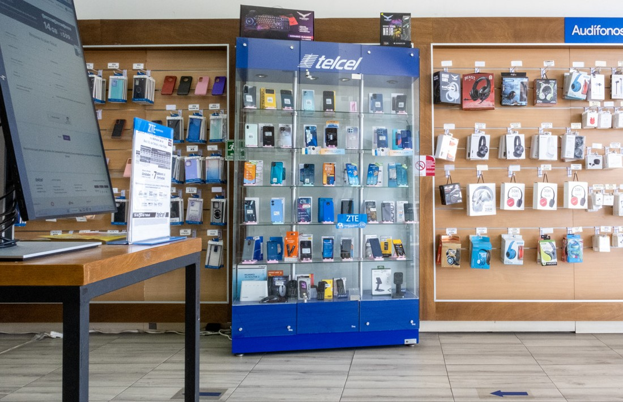
Project Overview
Using all the tools learned during the boot camp, such as, Python, Postgres, Tableau and machine learning, the aim of this project consists in developing a model that generates a demand prediction based on different variables like location, make, model and season.

Slide 5
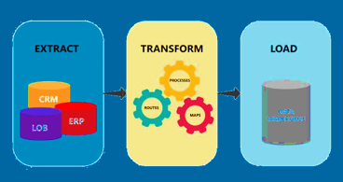
Description of the source of Data
The data was obtained by accessing to Odoo (suite of business management software), an ERP system of Dimovil.
Odoo process information in PostgreSQL. However, due to a limited access to the SQL system, we had to download the information in CSV files.
Description of the Data Exploration phase of the project
Obatiened 5 different csv files as follows:
Stock_move.csv → Flow of inventory within branches
Ventas_online.csv → Credit sales
Pdv_line → Cash payment sales
Productos → Stock (Product Catalogue – Inventory/Category)
Almacenes → Branches
Extracted, transformed and loaded our data.

Slide 6
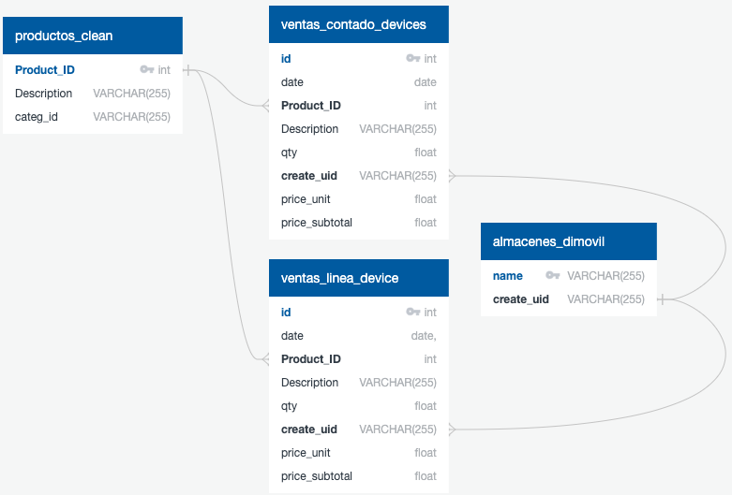
After extracting, cleaning and transforming our data, we generated our Entity Relationship Diagram (ERD) to further load them and create our tables to merge them in PostgreSQL

Slide 7

Questions to be answered
Which are the cell phone devices that generate the highest turnover?
Does cellphone demand change between branches?
Is there a way to identify or avoid purchasing low turnover inventory of cellphone devices that may become obsolete?
Is it possible to select 3 variables and obtain a future forecast for an specific product?

Slide 8
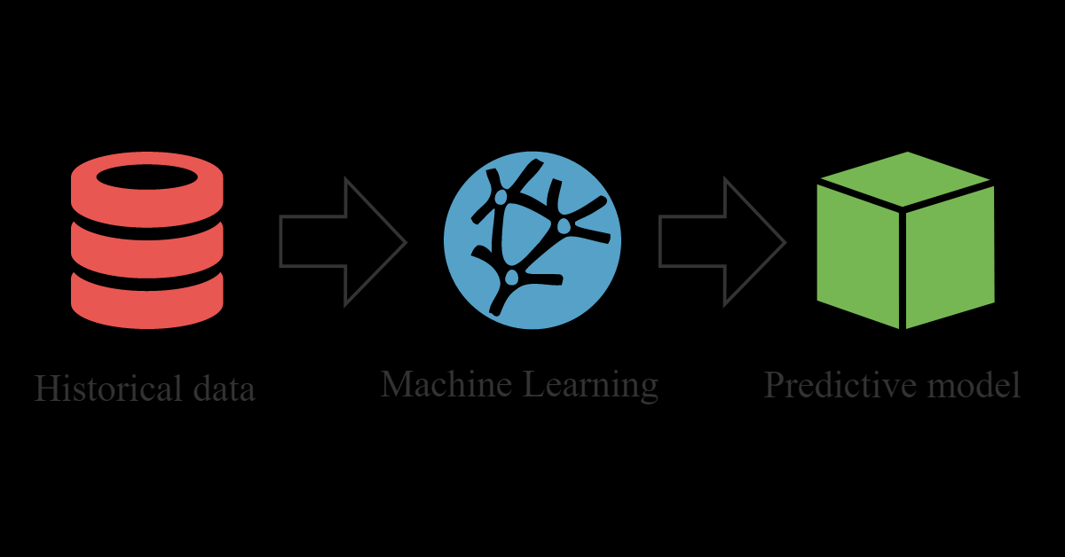
Technologies, langauages, tools and algorithms
We used the following
Programming Language → Python
Libraries → Pandas, Numpy, Matplotlib, Sklearn,et
Language for managing and querying relations with our database → PostgresSQL
Machine Learning Algorithms
Linear Regression
Random Forest Regression
XGBoost algorithm
Visualization tool → Tableau

Slide 9

Description of the analysis phase of the project
After extracting, cleaning and transforming our data, we generated our Entity Relationship Diagram (ERD) to further create our tables and merge them in PostgreSQL (file name: Merge_Tables.sql). As a result of that we obtained a new CSV file (final_ventas.csv) which will be grouped by store name, product brand, month, qty and total sales, previous to start our machine learning model. In that way, we might be able to predict the amount of cell phone sales per brand, store and per each month.
This will also help Dimovil identify which kind of inventory should keep in each store, each month.

Slide 10
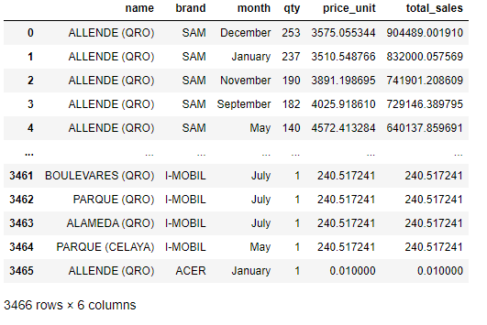
Results of the Analysis
We merged our 5 csv files into 1 and generate our DF, which will be grouped by store name, product brand, month, qty and total sales, previous to start our machine learning model
**This is our input to start our ML model

Slide 11
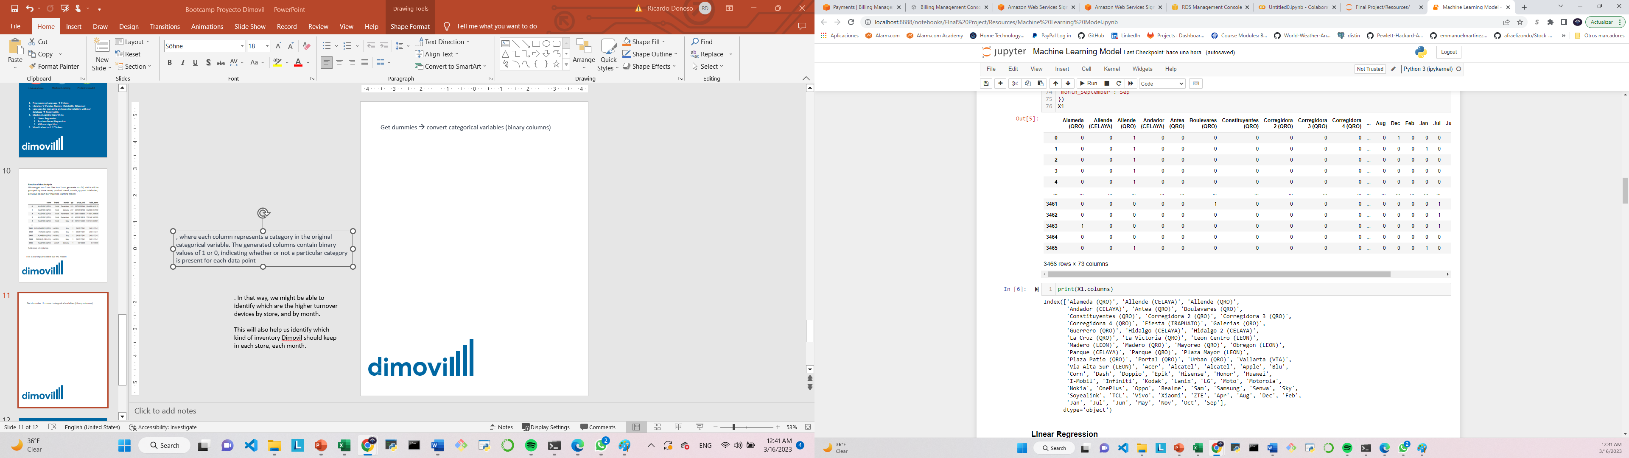
Get dummies → convert categorical variables (binary columns)
Each column represents a category in the original categorical variable.
The generated columns contain binary values of 1 or 0, indicating whether or not a particular category is present for each data point
Machine Learning Models – Algorithms
Linear Regression
Random Forest Regression
XGBoost regression

Slide 12
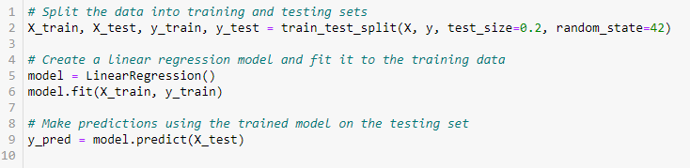
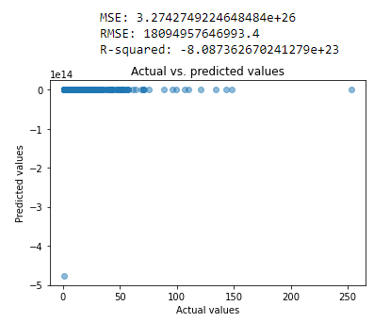
Machine Learning Models
Linear Regression

Slide 13
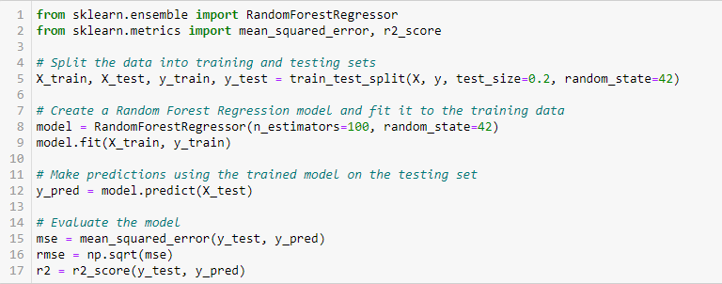
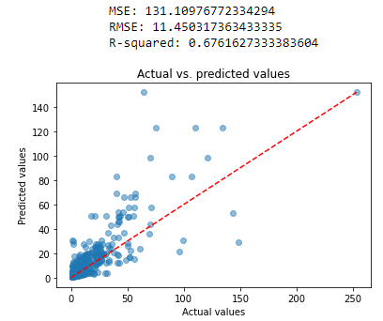
Machine Learning Models
Random Forest Regression
, where each column represents a category in the original categorical variable. The generated columns contain binary values of 1 or 0, indicating whether or not a particular category is present for each data point
. In that way, we might be able to identify which are the higher turnover devices by store, and by month.
This will also help us identify which kind of inventory Dimovil should keep in each store, each month.

Slide 14
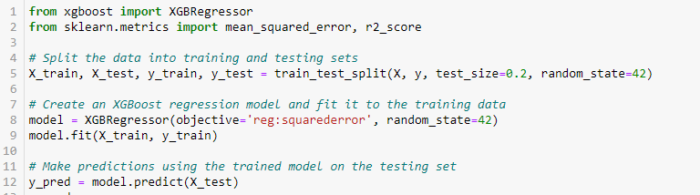
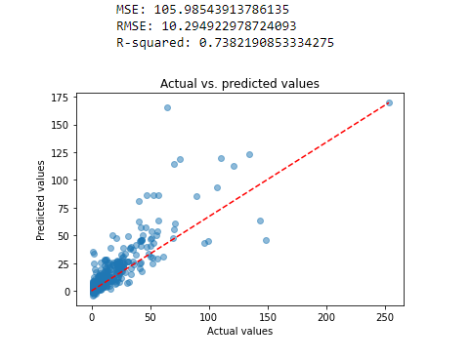
Machine Learning Models
XGBoost Regression
, where each column represents a category in the original categorical variable. The generated columns contain binary values of 1 or 0, indicating whether or not a particular category is present for each data point
. In that way, we might be able to identify which are the higher turnover devices by store, and by month.
This will also help us identify which kind of inventory Dimovil should keep in each store, each month.

Slide 15
Machine Learning Models
Explanation of model choice, including limitations and benefits
XGBoost → performed better than the other 2
It's always important to evaluate a model using multiple metrics
Compare the results between models → most suitable for your needs
A lower mean squared error (MSE) indicates better performance, and your model achieved an MSE of 105.99, which suggests that it is making relatively accurate predictions.
RMSE: The root mean squared error = 10.29, indicates that, on average, the model's predictions are within +/- 10.29 units of the actual target values.
The R-squared (or coefficient of determination) = 0 indicates that the model's predictions are no better than the baseline, while an R-squared of 1 indicates perfect fit. In this case. T
Our model achieved an R-squared of 0.74, which suggests that it explains a significant portion of the variation in the target variable beyond what the baseline model could capture.

Slide 16
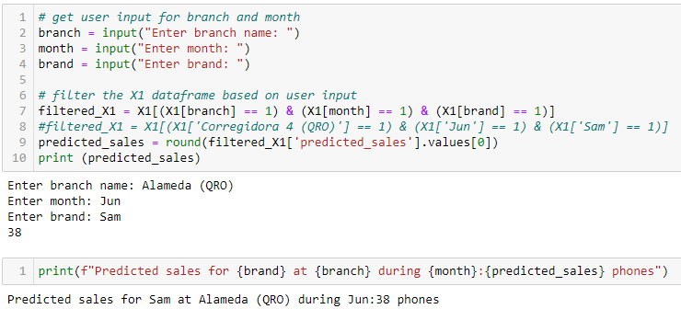
Result of testing the model

Slide 17
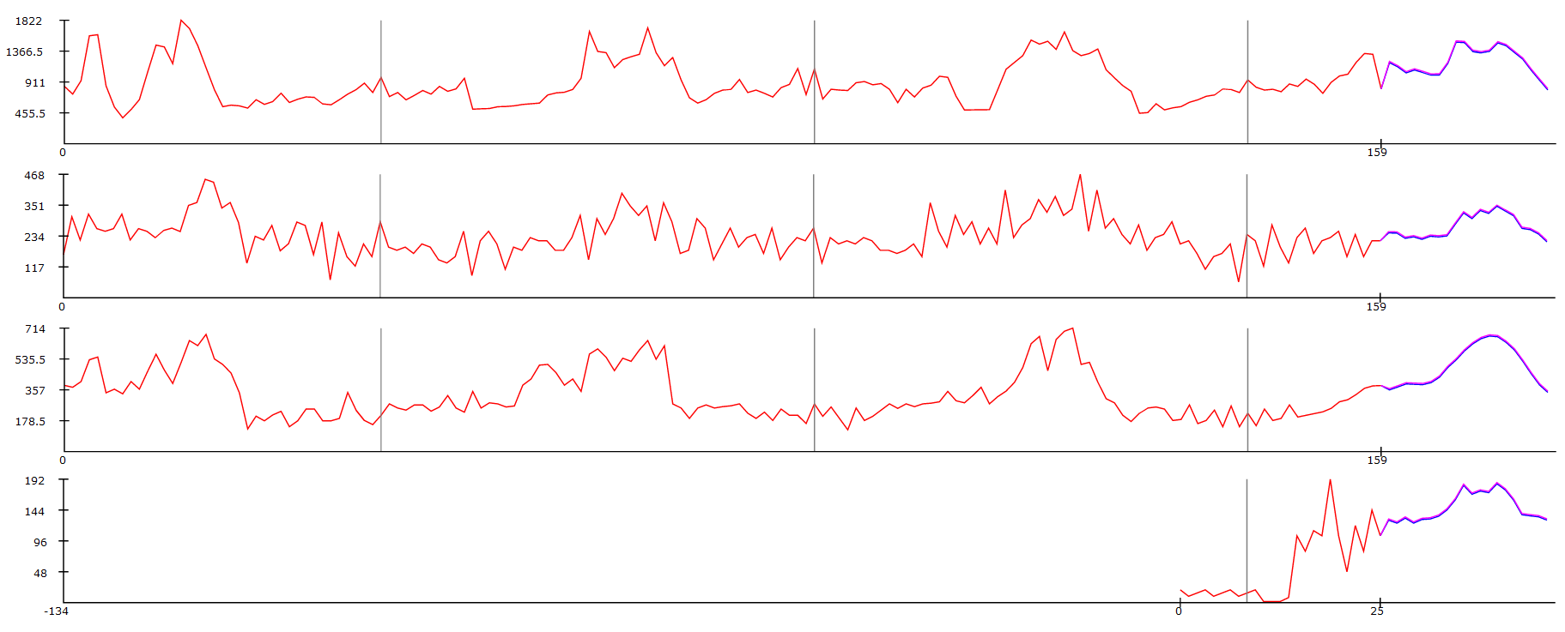
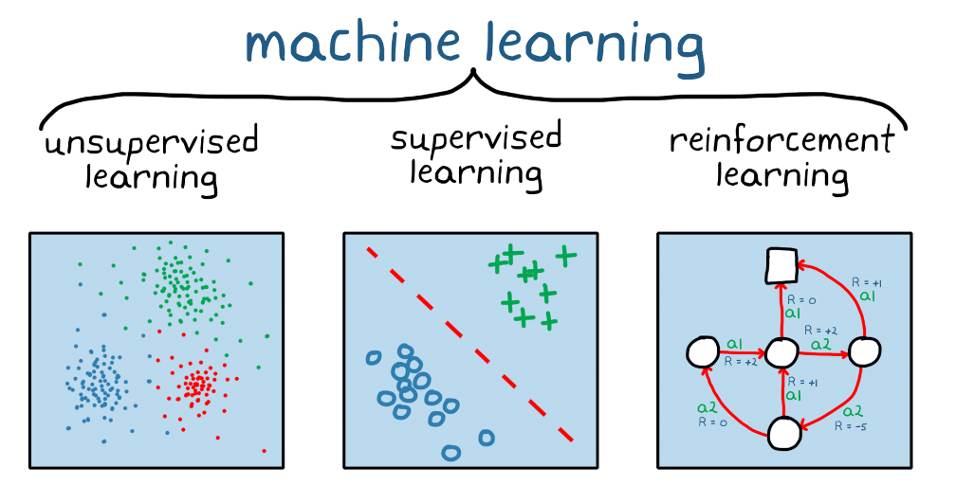
Recommendation for future analysis
After the project was done, there were realized many things that we could recommend for future analysis, and two of them are the following:
It would be highly recommended to extract information for, at least, 3 years. This, to have an seasonality trend to obtain the forecast.
Investigate about what machine learning models fit the most to what you are looking for.
What the team have done different?
The main problema during the project, was to found a machine learning model that best suits what we were looking for, so we would investigate all the machine learning models before starting, and not sticking with the ones learned in class.

Slide 18
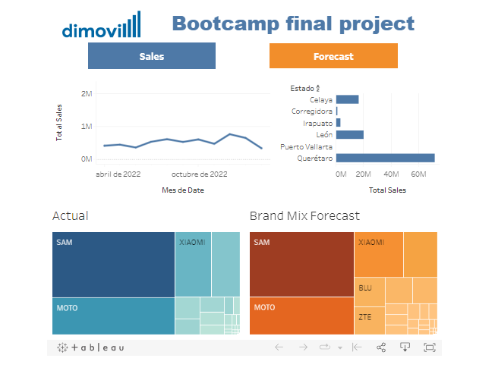
Dashboard
EMILIO INCLUIR TABLEAU

Slide 19
